Slide 1


WIPRO NGA PROGRAM - NMS BATCH
Capstone Project Presentation - 23 July 2024
Project Title - Configuration Database Microservice
PRESENTED BY -
1. Bishnu Prasad Mahato 6. Resh Jain
2. Raja Kumar Singh 7. Pratiksha Uttam Mogale
3. Praveen Chaurasia 8. Ruchi Kumari
4. Debakshmi Pan 9. Ranjeet Kumar
5. Ritik Patel 10. Dhiraj Kumar Singh

Slide 2



Configuring Database Microservice

Slide 3

INTRODUCTION
The Configuration Database Microservice is crafted to efficiently manage and store configuration data for network devices. This microservice is crucial for handling both current and historical configurations, ensuring that device settings can be accurately tracked and managed over time.
Its design prioritizes reliability and scalability, ensuring that configuration data is consistently accessible and maintainable. This approach enhances operational efficiency and supports effective device management across various network environments.

Slide 4

Necessary Tools :
Java Development Kit (JDK)
Maven or Gradle for project dependency management
IDE (e.g., IntelliJ IDEA, Eclipse)
Git for version control
Database management system (e.g., PostgreSQL, MySQL)
ORM framework (e.g., Hibernate)
Postman

Slide 5
Objective
Develop a Robust Microservice :​
​
The primary objective is to develop a robust and scalable microservice.
​
The service should be capable of managing configurations for a large number of devices.
Key Considerations: 1) Scalability 2) Reliability 3) Security 4) User Experience
​
​
Easy Configuration Management :​
​
The microservice should simplify the process of managing device configurations.​
Users should be able to easily create, update, delete, and retrieve configurations through the provided APIs.
Configuration operation: 1) Creation 2) Updation 3) Deletion 4) Retrieval​
​

Slide 6
Database Design :
Tables :
configurations: Holds current configuration data.
config_versions: Tracks historical versions of configurations
Relationships :
configurations can have multiple config_versions
establishing a one-to-many relationship.

Slide 7

Key Responsibility
1
2
3
4
Manage Configuration Data
API Management
System Integration
Version Control
Implement robust version control mechanisms to track changes over time
Provide APIs for creating, updating, deleting, and retrieving device configurations.
Ensure seamless integration with other systems to facilitate efficient configuration management.
Handle and store both current and historical configuration data

Slide 8
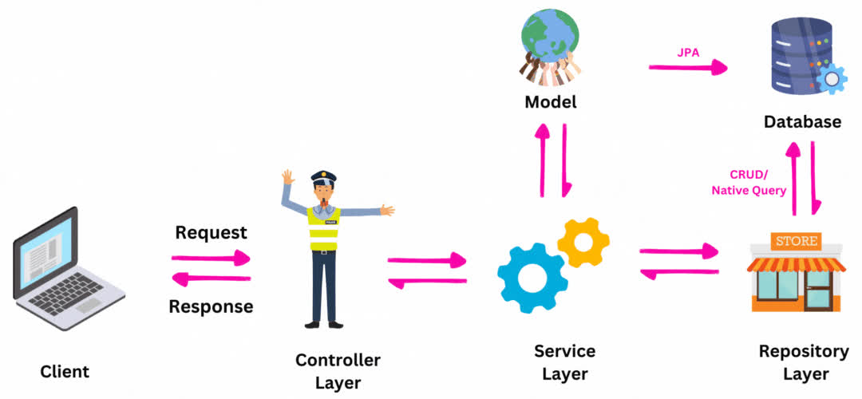
Architecture

Slide 9
Implementation
Entities
Configuration: Represents the configuration settings for a device.
ConfigVersion: Keeps track of different versions of configurations.
Repositories
ConfigurationRepository: Handles CRUD operations for Configuration entity.
ConfigVersionRepository: Handles CRUD operations for ConfigVersion entity.
Service
ConfigurationService: Interface defining the service methods.
ConfigurationServiceImpl: Implementation of ConfigurationService, providing the core business logic.

Slide 10



POST Method
Purpose: Create a new configuration.
Path: /api/configurations
Request Body: Configuration object
Response: Created configuration (2O1 CREATED)
GET Method
Purpose: Get configurations for a specific device.
Path: /api/configurations/{deviceId}
Response: List of configurations (200 OK)

Slide 11
PUT Method
Purpose: Modify an existing configuration.
Path: /api/configurations/{id}
Request Body: Updated Configuration object
Response: Updated configuration (200 OK) or
Failure ( 404 Not Found if configuration does not exist)
DELETE Method
Purpose: Remove an existing configuration.
Path: /api/configurations/{id}
Request Body: None
Response: Status indicating success or failure ( 204 No Content or 404 Not Found if configuration does not exist)

Slide 12
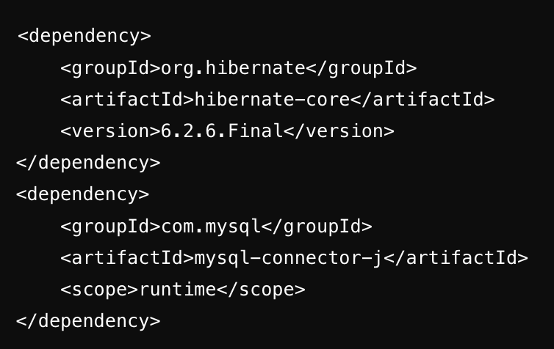
Adding ORM in pom.xml
Include Hibernate ORM in the pom.xml to enable mapping Java objects to database tables.
This simplifies database interactions and ensures seamless data persistence.

Slide 13
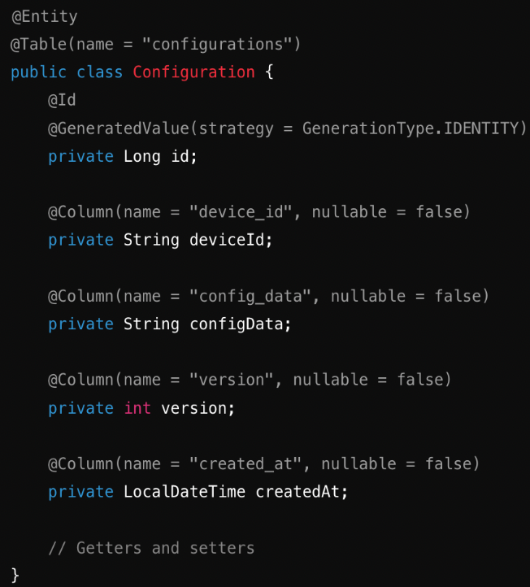
Conversion
CREATE TABLE configurations (
id INT AUTO_INCREMENT PRIMARY KEY,
device_id VARCHAR(255) NOT NULL,
config_data JSON NOT NULL,
version INT NOT NULL,
created_at TIMESTAMP NOT NULL DEFAULT CURRENT_TIMESTAMP
);

Slide 14
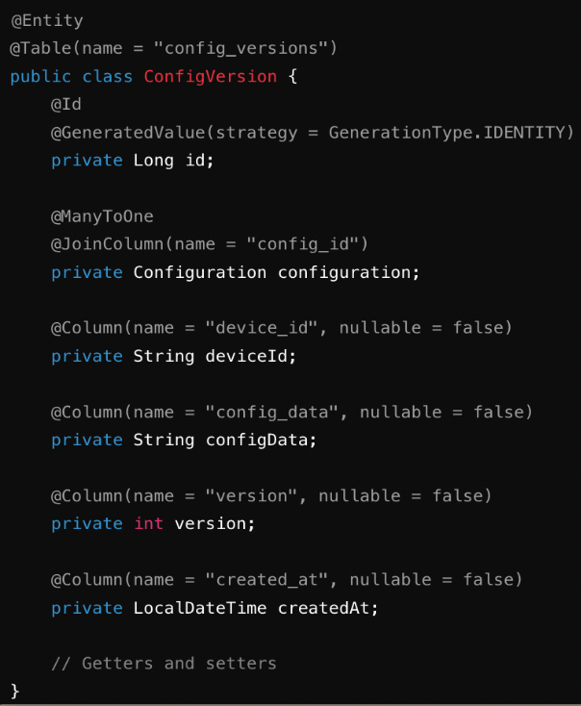
Conversion
CREATE TABLE config_versions (
id INT AUTO_INCREMENT PRIMARY KEY,
config_id INT,
device_id VARCHAR(255) NOT NULL,
config_data JSON NOT NULL,
version INT,
created_at TIMESTAMP NOT NULL DEFAULT CURRENT_TIMESTAMP,
FOREIGN KEY (config_id) REFERENCES configurations(id)
);

Slide 15
Unit Testing
1. Repository Testing
Purpose: Validate data access methods.
Focus: Test repository methods for saving and retrieving configurations.
2. Service Layer Testing
Purpose: Verify business logic and service methods.
Focus: Test the service layer for correct handling of configurations.
3. Controller Testing
Purpose: Ensure correct API responses and request handling.
Focus: Test RESTful endpoints for creating and retrieving configurations.

Slide 16
Conclusion
The Configuration Database Microservice is essential for managing network device configurations, offering robust version control and change tracking. Its comprehensive APIs ensure seamless integration with other systems, streamlining operations like creating, updating, deleting, and retrieving configurations. This microservice provides a reliable and scalable solution for maintaining accurate device settings, enhancing overall operational efficiency.

Slide 17
References
https://www.baeldung.com/spring-boot-start
https://www.javatpoint.com/jpa-tutorial
https://docs.spring.io/spring-boot/documentation.html
https://git-scm.com/downloads

Slide 18



